Slide 1

Data Analytics for Business
Nonlinear Transformation Models
Sridhar Narasimhan, Ph.D
Professor
Scheller College of Business
Introduction to Nonlinear Models

Slide 2



Lessons in this Module
Introduction to Nonlinear Models
Linear-Log Model
Log-Linear Model
Log-Log Model
Polynomial Model

Slide 3
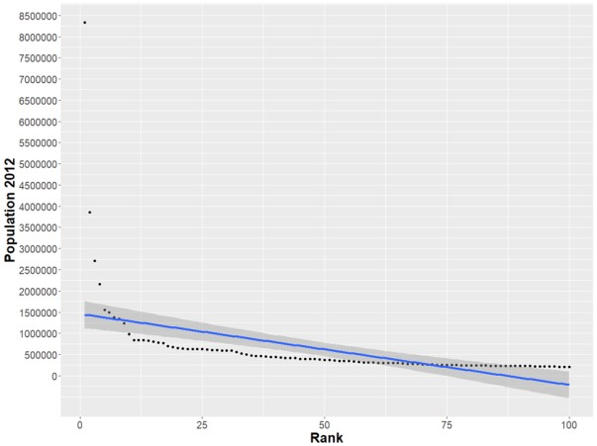

An Example of a Nonlinear Relationship
US City Population and Rank
Notes:
This is an example of a non-linear relationship.

Slide 4
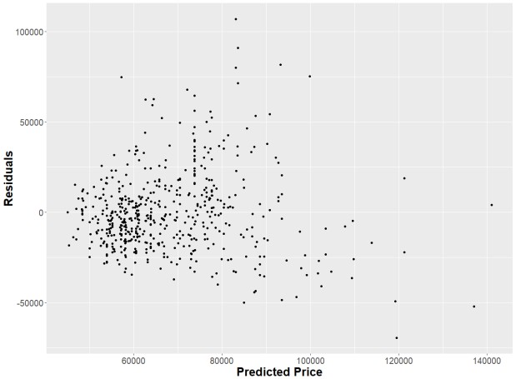
Another Example (From the Housing Dataset in the Ecdat Package in R)
Notes:
This data implies heteroscedasticity – that is the residuals have non-constant variance. The residuals increase as predicted price increases.

Slide 5
Model A: Linear-Linear Model
 | Estimate | S.E. | t Value | Pr>|t|
Intercept | 34140 | 2,491 | 13.7 | <.0001
lotsize | 6.599 | 0.4458 | 14.8 | <.0001
R-Squared | Adjusted R-Squared
0.2871 | 0.2858
Model A: price = b₀ + b₁*lotsize
As X (lotsize) increases by 1 unit, Y (price) changes by b₁ (6.599) units, holding all other factors constant

Slide 6
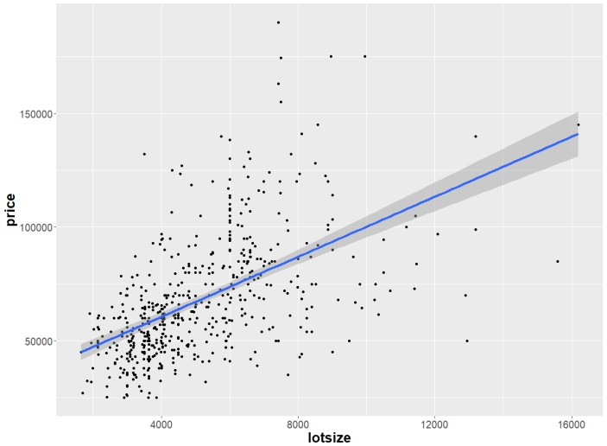
Model A: Scatter Plot

Slide 7
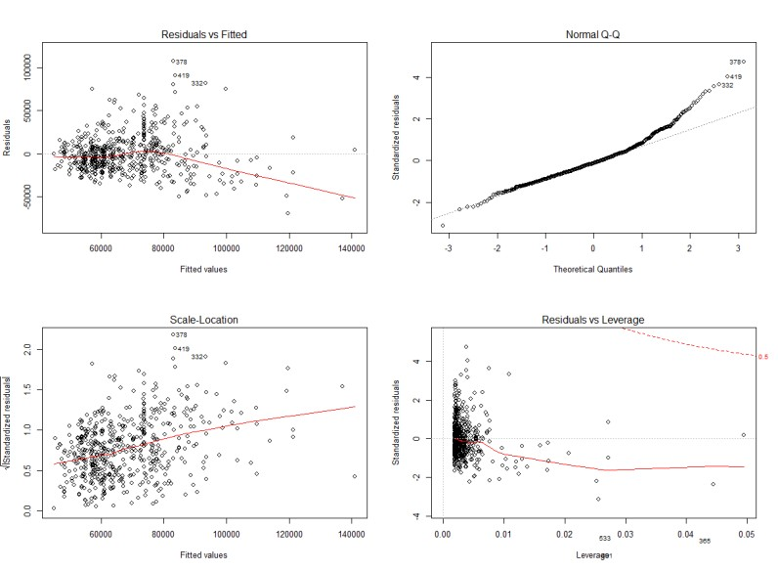
Model A: Diagnostics Plot
Notes:
The assumptions are – homoscedasticity, a normal QQ plot.

Slide 8
Model A: price = b₀ + b₁*lotsize Assumptions
We need to check if the assumptions for a linear regression model hold
The residuals vs. fitted values plot indicates that Model A has heteroscedasticity (non-constant variance); the QQ-plot suggest that there is non-linearity
Hence, we need to start exploring non-linear models
We focus on natural log transformations of the variables because they are
easier to interpret. Note that in R, log() computes the natural log

Slide 9
The Various Log Transformations
 | Y | log(Y)
X | Model A: Level-level model Y = b₀ + b₁*X
log(x)

Slide 10
The Various Log Transformations
 | Y | log(Y)
X | Model A: Level-level model Y = b₀ + b₁*X | Model C: Log-linear Model log(Y) = b₀ + b₁*X
log(x) | Model B: Linear-Log Model Y = b₀ + b₁*log(X) | Model D: Log-Log log(Y) = b₀ + b₁*log(X)
Note:
The log() function in R computes the natural logarithm
If a variable x has some values = 0, then use log(x+1) transformation
Notes:
T

Slide 11
Data Analytics for Business
Nonlinear Transformation Models
Sridhar Narasimhan, Ph.D
Professor
Scheller College of Business
Linear-Log Model

Slide 12
Model B: Linear-Log Model Independent
Variable Transformed
 | Estimate | S.E. | t Value | Pr>|t|
Intercept | -250,728 | 20,184 | -12.42 | <.0001
Ln_lotsize | 37660 | 2381 | 15.81 | <.0001
R-Squared | Adjusted R- Squared
0.315 | 0.3137
Model B: price = b₀ + b₁*log(lotsize)
Create a new variable Ln_lotsize which is the natural log of lotsize
Run Model B using the Housing dataset
How would you interpret the coefficient of Ln_lotsize?

Slide 13
Model B: price = b₀ + b₁*log(lotsize)
What does the coefficient b₁ = 37660 imply?
When lotsize increases by 1 sq foot, price increases (on average) by $37,660.
When lotsize decreases by 1 sq foot, price increases (on average) by $37,660.
When lotsize decreases by log(1), price increases (on average) by $376.60.
When lotsize increases by 1%, price increases (on average) by $376.60.
What is the correct answer?
D. A one percent increase in the independent variable increases (or decreases) the dependent variable by (coefficient/100) units.
Notes:
The difference between ln(x) and ln(x*1.01) is around .01

Slide 14
Interpreting a Linear-Log Model
Linear-log model (and most other models) needs to be interpreted carefully
It does not make much practical sense to increase the “log(lotprice)” by one unit
But increasing X by 1 percent is almost equivalent to increasing (natural)
log(X) by 0.01 units
Hence, a 1 percent increase in X increases (natural) log(X) by .01 and, therefore, changes the Y variable by .01*b₁

Slide 15
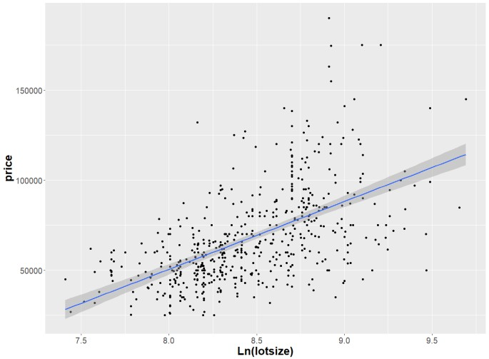
Model B: Scatter Plot

Slide 16
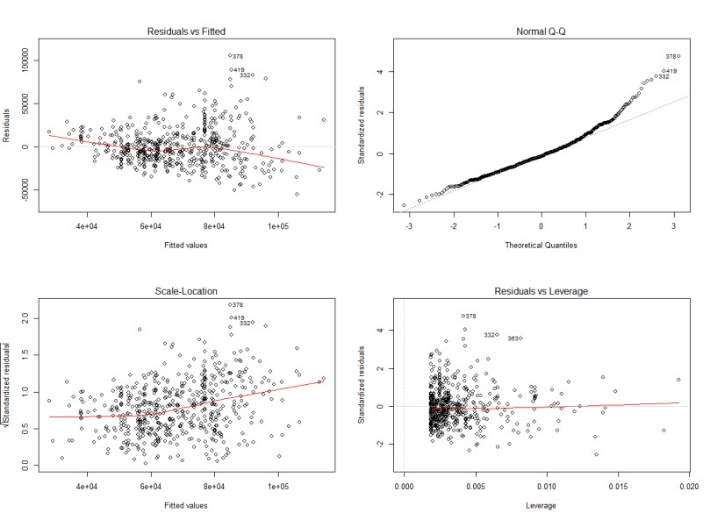
Model B: Diagnostics Plots
Notes:
Even with the transformation – the QQ plot is still problematic, as is the residuals plot.

Slide 17
Data Analytics for Business
Nonlinear Transformation Models
Sridhar Narasimhan, Ph.D
Professor
Scheller College of Business
Log-Linear Model

Slide 18
Model C: Log-Linear Model Dependent Variable Transformed
 | Estimate | S.E. | t Value | Pr>|t|
Intercept | 10.58 | .03451 | 306.51 | <.0001
lotsize | .00009315 | .000006177 | 15.08 | <.0001
R-Squared | Adjusted R- Squared
0.2947 | 0.2935
Model C: log(price) = b₀ + b₁*lotsize
Create a new variable Ln_price which is the natural log of price
How would you interpret the coefficient of lotsize?

Slide 19
Model C: log(price) = b₀ + b₁*lotsize
What does the coefficient b₁ = .00009315 imply in a log-linear model?
When lotsize increases by .01 sq. ft., price increases by .009315% (on average)
When lotsize increases by 1 sq. ft., price increases by .009315% (on average)
When lotsize increases by 1 sq. ft., price decreases by .009315% (on average)
When lotsize decreases by 1 sq. ft., price increases by .009315% (on average)
What is the correct answer?
B. The dependent variable changes by 100*(coefficient) percent for a one unit increase in the independent variable while all other variables in the model are held constant

Slide 20
Interpreting the Log-linear Model
log(price) = b₀ + b₁*lotsize
Increasing x by one unit will increase (natural) log(y) by b₁ units
With x = lotsize, the model log(price) = b₀ + b₁*x is the same as
𝑦 = 𝑒^{(𝑏0+𝑏1𝑥)}. Hence, dy/dx = b₁y, or dy/y = b₁*dx
Multiplying both sides by 100, we get 100*dy/y = 100*b₁*dx
Note that (100*dy/y) is the percentage change in Y
If dx = 1, then this one unit change in x leads to a 100*b₁ percentage change in Y
Note: this interpretation works when b₀ + b₁*x is very small
The accurate percentage change in Y = (𝑒^{𝑏1} - 1)*100 for a one unit change in X

Slide 21
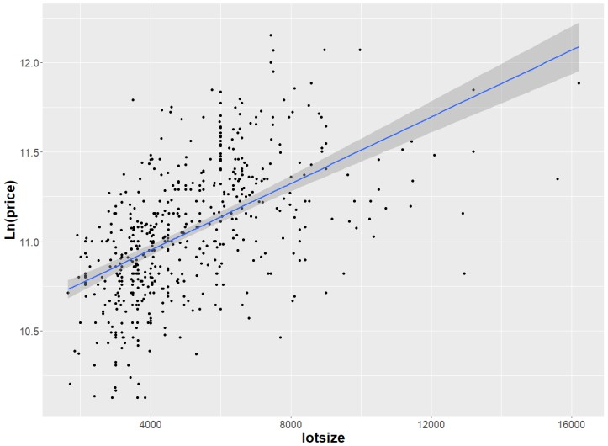
Model C: Scatter Plot

Slide 22
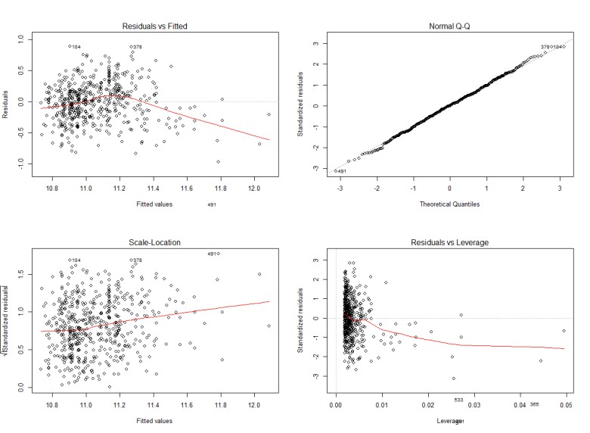
Model C: Diagnostic Plots

Slide 23
Data Analytics for Business
Nonlinear Transformation Models
Sridhar Narasimhan, Ph.D
Professor
Scheller College of Business
Log-Log Model

Slide 24
Model D: Log-Log Model
 | Estimate | S.E. | t Value | Pr>|t|
Intercept | 6.46853 | 0.27674 | 23.37 | <.001
lotsize | 0.54218 | 0.03265 | 16.61 | <.001
R-Squared | Adjusted R- Squared
0.3364 | 0.3352
Model D: log(price) = b₀ + b₁*log(lotsize)
The dependent and the independent variables are log transformed
How do you interpret the coefficient of lotsize?

Slide 25
Model D: Log-Log Model
log(price) = b₀ + b₁*log(lotsize)
b₁ = 0.54218 implies that
When lotsize increases by 1%, price increases (on average) by 0.54218%
When lotsize decreases by 1%, price increases (on average) by 0.54218%
When lotsize increases by 1 sq. ft., price increases (on average) by 0.54218%
When lotsize decreases by 1 sq. ft., price increases (on average) by 0.54218%
What is the correct answer?
Answer -- A. The dependent variable changes by b₁% percent for a one percent increase in the independent variable while all other variables in the model are held constant

Slide 26
Interpreting the Log-Log Model
Increasing (natural) log(X) by 0.01 leads to increasing (natural) log(Y) by b₁
*0.01 units
Increasing (natural) log(X) by 0.01 is almost equivalent to increasing X by 1 percent, which implies changing Y by b₁ percent
In a regression setting, we'd interpret elasticity as the percent change in Y (the dependent variable), when X (the independent variable) increases by one percent
Hence b₁ captures elasticity

Slide 27
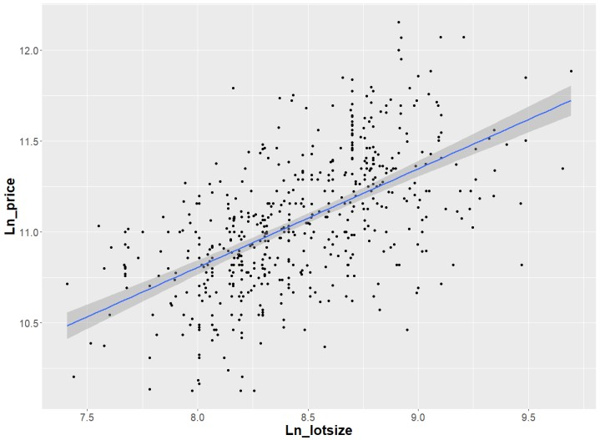
Model D: Scatter Plot

Slide 28
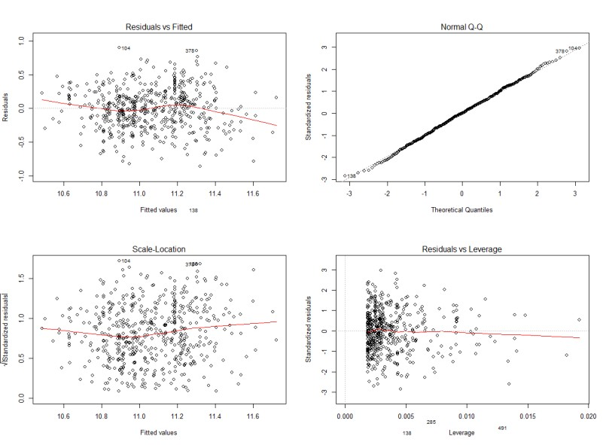
Model D: Diagnostics Plot

Slide 29
Comparing the Models
 | R-Squared | Adjusted R-Squared
Model A: Level-Level | 0.2871 | 0.2858
Model B: Linear-Log | 0.3150 | 0.3137
Model C: Log-Linear | 0.2947 | 0.2935
Model D: Log-Log | 0.3364 | 0.3352

Slide 30
Reasons for (log) Transforming Data
To achieve a (more) linear relationship
To make a distribution more normal
To make the variance more constant
To get a better fit in the model – i.e., increase R-Squared

Slide 31
Log Transformations Cheat Sheet
 | Y | log(Y)
X | Model A: Level-Level model Y = b₀ + b₁*X As X increases by 1 unit, Y changes by b₁ units, holding all other factors constant. | Model C: Log-Linear Model log(Y) = b₀ + b₁*X As X increases by 1 unit, Y increases by (b₁*100)%, holding all other factors constant.
log(x) | Model B: Linear-Log Model Y = b₀ + b₁*log(X) As X increases by 1%, Y increases by (b₁/100) units, holding all other factors constant. | Model D: Log-Log log(Y) = b₀ + b₁*log(X) As X increases by 1%, Y changes by b₁%, holding all other factors constant.

Slide 32

Data Analytics for Business
Nonlinear Transformation Models
Sridhar Narasimhan, Ph.D
Professor
Scheller College of Business
Polynomial (Quadratic) Model

Slide 33
Model E: Polynomial (Quadratic) Model
 | Estimate | S.E. | t Value | Pr>|t|
Intercept | 11,340 | 4,892 | 2.317 | .0209*
lotsize | 14.81 | 1.589 | 9.317 | <.0001
lot_square | -6.238e-04 | 1.162e-04 | -5.370 | <.0001
R-Squared | Adjusted R-Squared
0.323 | 0.3205
Model E: price = b₀ + b₁*lotsize + b₂*lotsize²
Create a new variable lot_square = lotsize²
Fit the model, price = b₀ + b₁*lotsize + b₂*lotsize²

Slide 34
Model E: price = b₀ + b₁*lotsize + b₂*lotsize²
The coefficient b₁ = 14.81 implies that
When lotsize increases by 1 sq. ft., price will increase by $14.81
When lotsize decreases by 1 sq. ft., price will increase by $14.81
When lotsize increases by 1%, price will increase by $14.81
None of the above
What is the correct answer?
D: None of the above

Slide 35
Model E: Interpreting a Polynomial
(Quadratic) Model
price = b₀ + b₁*lotsize + b₂*lotsize²
Coefficients b₁ and b₂ cannot be interpreted individually because when lotsize is increased by 1 unit, it is not possible (or meaningful) to hold lotsize² constant
A quadratic model does not allow for an isolated interpretation of coefficients
_{since} 𝑑(𝑝𝑟𝑖𝑐𝑒)
= b₁ + 2b₂∗lotsize
𝑑(𝑙𝑜𝑡𝑠𝑖𝑧𝑒)
This means that the slope (impact of 1 unit increase in x) is not a constant. It changes at every point of the quadratic curve (if you plot y vs. x)

Slide 36
Recap of this Module
Introduction to Nonlinear Models
Linear-Log Model
Log-Linear Model
Log-Log Model
Polynomial Model

